Slide 1
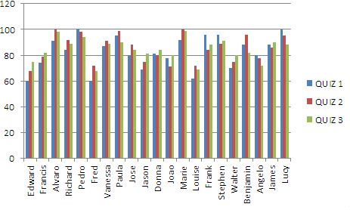
Column Charts
Alex, Dylan, and Courtney
Using Activity 10, Quiz Scores

Slide 2
Column Charts
A column chart, also called a bar chart, is a chart that is commonly used for comparing data over time or to compare products.

Slide 3
Column Charts
When creating a chart in Excel, you must first enter the data into your workbook. We used the Activity 10 Quiz Scores workbook as an example.

Slide 4
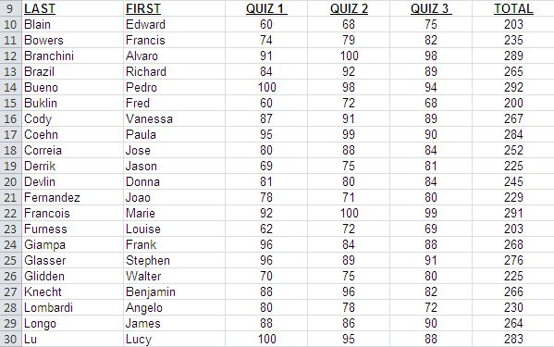

Slide 5
Column Charts
Once you have entered your data into the excel workbook, you can now convert it into a column chart.
Begin by highlighting the content that you want to insert into the chart, and then clicking the chart bar in your insert ribbon.

Slide 6
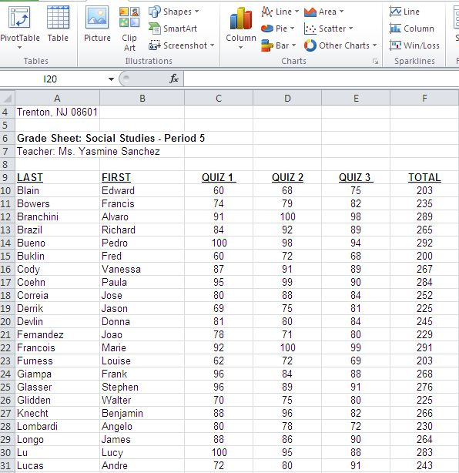

Slide 7
Column Charts
When your information is selected, and you click on the chart option you will get a drop-down menu of the chart possibilities.
We picked a 2D chart for this demonstration.

Slide 9
Column Charts
The data is now organized in an easy to read column chart.
This column chart illustrates a group of students’ quiz scores over a period of three quizzes.

Slide 10
Steps Recap
Insert information into an excel workbook.
Highlight information you would like to include in your chart.
Open the chart tab in your insert ribbon.
Select the type of chart you would like to use.
Try it!

